Slide 1
Weekly report 2nd April 2018
Huy-Hung Ho
Key Laboratory for Smart Integrated Systems (SISLAB),
VNU University of Engineering and Technology (VNU-UET)

Slide 2
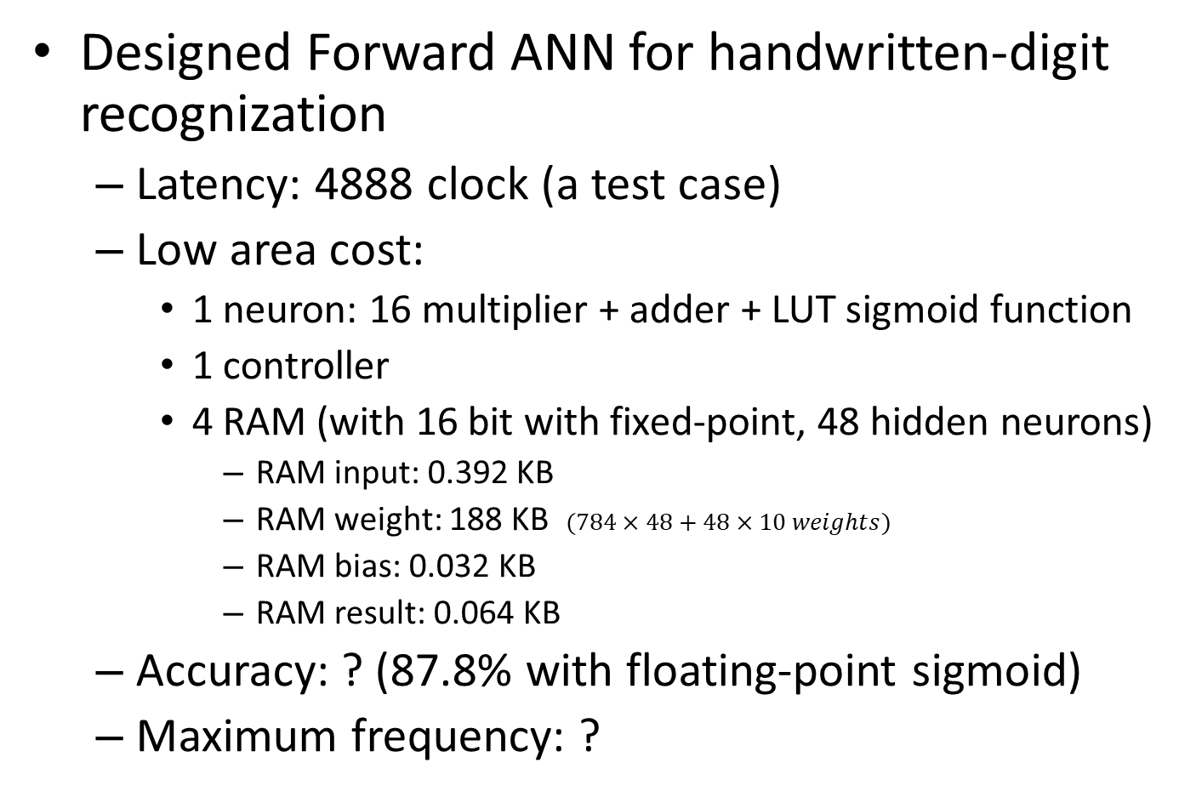
Completed work
Designed Forward ANN for handwritten-digit recognization
Latency: 4888 clock (a test case)
Low area cost:
1 neuron: 16 multiplier + adder + LUT sigmoid function
1 controller
4 RAM (with 16 bit with fixed-point, 48 hidden neurons)
RAM input: 0.392 KB
RAM weight: 188 KB $(784×48+48×10 weights)$
RAM bias: 0.032 KB
RAM result: 0.064 KB
Accuracy: ? (87.8% with floating-point sigmoid)
Maximum frequency: ?

Slide 3
Context & Motivation
Open-source architecture
Tested in Artix-7 FPGA
Use 1 neuron for all architecture
Requirement architecture
Use SC -> Parallel -> Neuron with N-input
Able to apply for FPGA

Slide 4
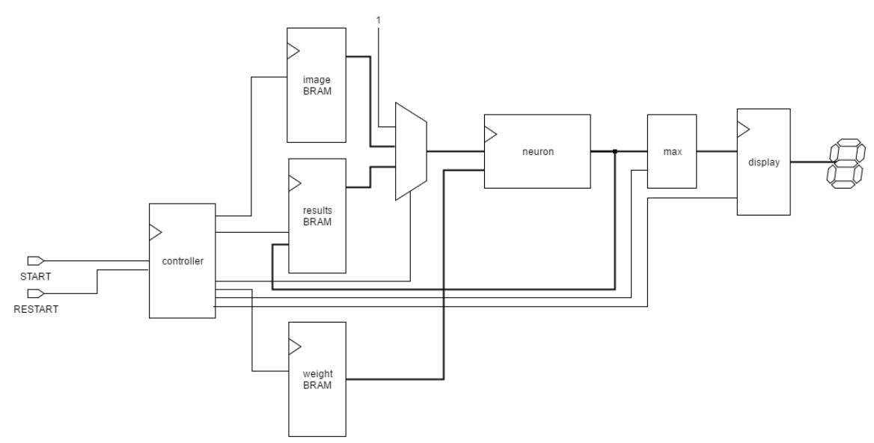
Open-source architecture
Bias
BRAM

Slide 5
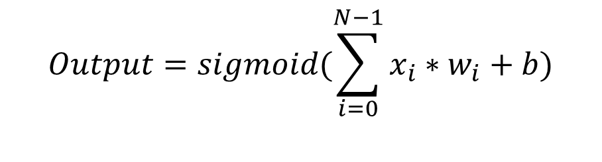
Proposed neuron module
$$Output=sigmoid(\sum_{i=0}^{N−1}{x_{i}∗w_{i}+b)}$$
LUT
sigmoid Function
Bias
Multiplier &
Binary Tree Adder
Output
16
Input
+
+
Sum
16 Weight
Weighted input Calculation

Slide 6
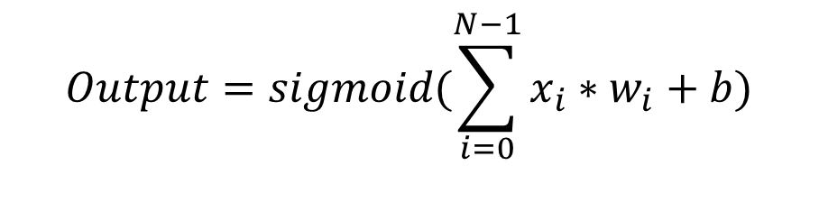
Proposed neuron module (cont.)
$$Output=sigmoid(\sum_{i=0}^{N−1}{x_{i}∗w_{i}+b)}$$
Bias
LUT sigmoid Function
Multiplier
Binary tree Adder
16
Input
Sum_tmp
+
+
Save to RAM without register
16 Weight
Weighted input Calculation
Mult

Slide 7
Next week
Writing thesis
ANN Theory
Stochastic Computing Theory
Design SC neuron (Stochastic Computing)
FPGA implementation
Print recognization result on LCD

Slide 8
THANKS FOR YOUR ATTENTION

